Slide 2
Focus Forward Enterprises
It all starts with communication

Slide 3
High Performance Communication
We believe that in order to truly maximize the human performance engine with in any person you must have a working knowledge and understanding the function and relationship of the brain and the body.
It all starts with communication, the format in which we arrange our thoughts and words have a very important roll in how effective our communication efforts may be.

Slide 4
Communication
Why we wish to communicate, or sometimes why should someone listen to what
you have to communicate are often the most important questions to ask your self,
versus what it is you really want to say.
The best companies and leaders in history have managed to do something that
continues to separate them from the masses. It all has to do with how they
communicate their message.
High Performance Communication has three basic characteristics: Clarity, Discipline
and Consistency. We will explore each of these components which can then be applied
to your personal as well as business and organizational communication engagements.

Slide 5
The Power Circle
PRIMAL
LIMBIC
COGNITIVE
WHY
HOW
WHAT
Notes:
Why- Your belief
How- Actions that support your WHY through values
What- Product or service will be the result

Slide 6
Clarity of WHY
Knowing your WHY or your organizations WHY is not the only way to be successful, but it is the only way to maintain a lasting success and have a greater blend of innovation and flexibility.
“People don’t buy WHAT you do, they buy WHY you do it” – Simon Sinek

Slide 7


Performance of WHY
Stop sales and marketing and start communicating – Michael Torres
Classic Success Model
Great Price
Most Features
Best Quality
Best Service
Up to a 6 month wait for product
25% higher price
How do these brands maintain a loyalty base that will tattoo their logo on their own body, and wait outside of a retail store for hours?

Slide 8
Discipline of How
Most businesses have some sort of values, usual words that would appear to be of some
moral value to the owner and it’s employees.
Integrity & Honesty
On face value, if these words are part of your personal mantra or company values, you
would say that yes I would like a business that possesses these traits. Let’s deep dive on
these to two words and first and foremost identify them for what they are- nouns.
The problem with that is they are not “Actionable” in this form, they just sound good. It
takes discipline to continue to act on your values and make everything you do relate to your
WHY

Slide 9
How in action
The first step in understanding how to communicate your “How” is to examine your
own filter, or in other words, how you see the situation.
If you have established a set of value principles for yourself or your organization, then
write them down at this point and explain for each of them what they look like in action.
For example: Integrity – We will ensure the highest quality of service each time we
stand and deliver. We support this promise to quality by honoring our 100% money back
guarantee. – Integrity can be looked at in this view as following through no matter what, if you loose money or not you will stand by your promises. When consumers trust this, they are less likely to pursue or challenge this type of promise.

Slide 10
Consistency of WHAT
Everything you say and everything you do has to prove what you believe. A WHY
is just a belief. The How’s are the actions you take to realize the belife, and the
WHAT’s are the results of those actions – EVERYTHING: your services, your
products, communications, culture, and the people you hire.
What does it mean to be your customer, who do your customers feel they identify with or belong to?
How do you assist in helping us identify with what you believe?

Slide 11
High Performance Communication Planning
Any interaction planned by you should have an actual plan in place. Whether you
begin using the following exercise in it’s entirety until you understand the application
process or you make this plan standard in your organization; implementing the following
system will change you and your organizations communicate.
It is a false assumption that differentiation happens in HOW and WHAT
you do. Simply offering a high-quality product with more features or
better service or a better price doesn’t create difference. Differentiation
happens in WHY and HOW you do it.

Slide 12
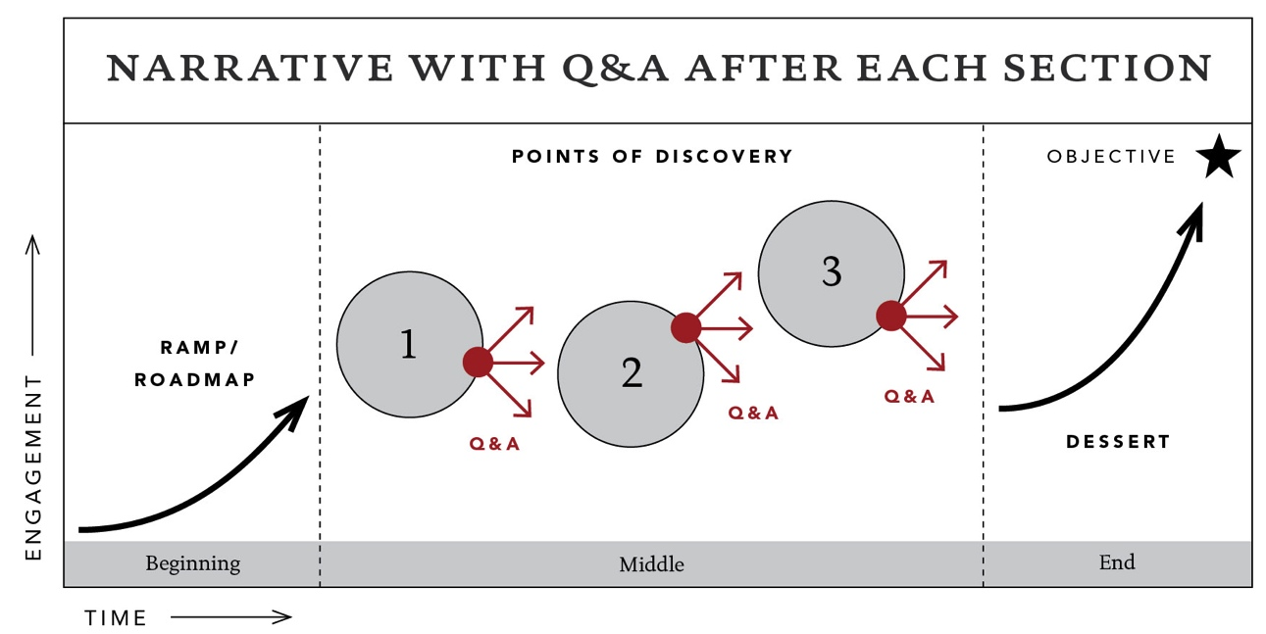
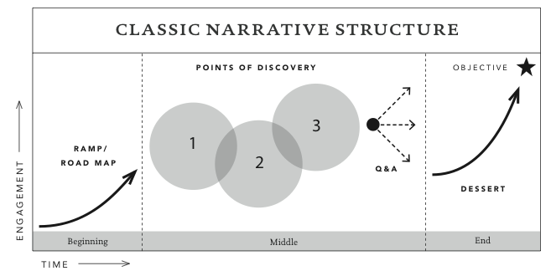
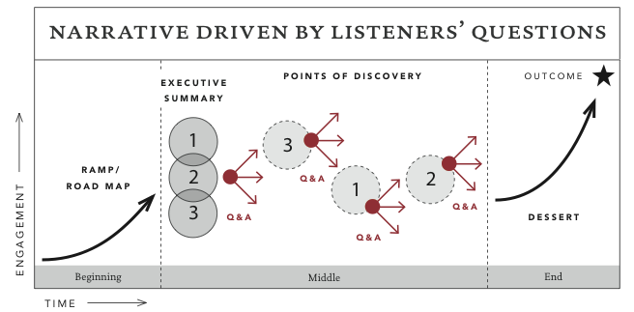
The Roadmap
No matter what your objective, in order to effectively communicate you must establish a flow. There are various options, which would be suited best based on a number of factors. These are just a few options.

Slide 13
Communications Outline
Heading: Who’s listening? Clearly identify your audience and identify with your audience
Step 1: By the end of the conversation, the will decide to/
agree to: ________
1a) In order to achieve this they need to know _____ and
feel _____
Step 2: Why should they care
Step 3: What’s your message in one sentence?

Slide 14
Communications in Action
Ramp
Pts. of Discovery
Dessert
Purpose
Know / Feel
Story
Notes:
Ramp- Build repore by gaining the common belief in WHY
PTS of discovery

Slide 15
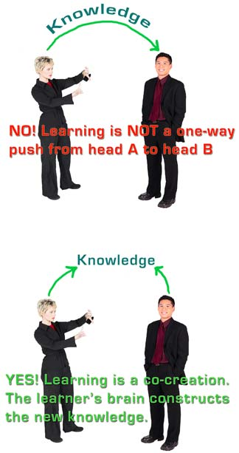
Communication Super Highway
4 Steps to Effective Listening
Receive
Appreciate
Summarize
Ask

Slide 16
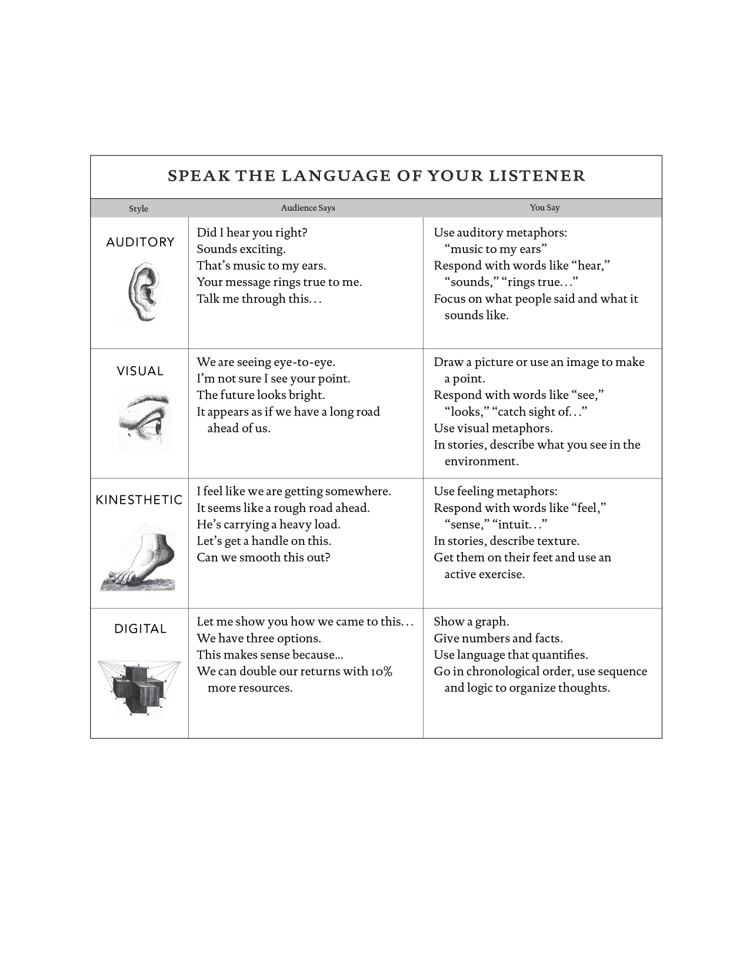
The language of communication

Slide 17
5 Keys to success!
Tell a story
Chunk the information
Control your pace
Take them to the next level
I vs U

Slide 18

Coaching Communication
Notes:
So you have your thoughts organized but what about

Slide 19

So you have clients now what?
Taking your clients to the next
level is more then a shared belief!
What you say finds it’s place in the
session- how do you coach your clients
has scientific relevance…….
FOCUS

Slide 20
Neuroscience of Focus
Your brain can only focus on
one thing at a time

Slide 21

Coaching Cues
Lower like an accordion
drop your hips back
Pull your hips down like a
magnet to the floor
Keep your numbers up
keep your chest up
Bring the top of your head
straight through the roof
Fire your glutes
Drive with your legs
Push the ground away

Slide 22
Keys to external cues
Distance
Direction
Description
Create the Image = Ignite the memory

Slide 23
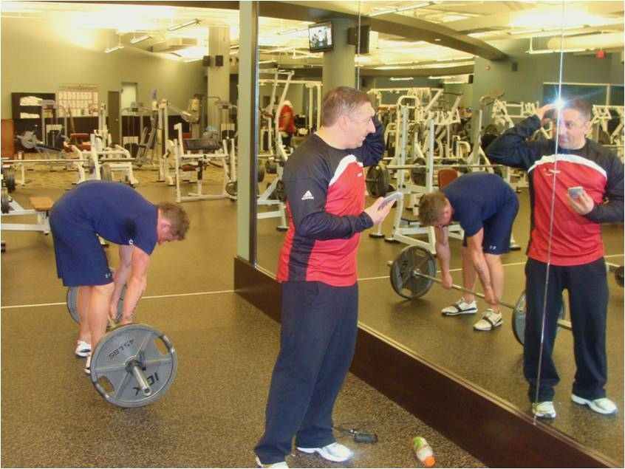
Experiential Learning
Experiencing
Reviewing
Concluding
Planning
Transfer of Learning

Slide 24


www.iperformanceinstitute.com
www.facebook.com/iperformance
mtorres@iperformanceinstitute.com

Slide 25

Your Coach
Michael Torres, founder of Focus-Forward Enterprises, believes that to truly optimize the performance of an individual or organization you have incorporate change through scientific based platforms that addresses both the brain and body as well as a plan to integrate these systems. Having conceptualized a unique system that not only offers a neuroscience based approach to movement and executive performance coaching, but the Transformational Performance Coaching program includes a matrix of sport and nutritional sciences to maximize the human experience. With partners such as the Body-Brain Performance company, Segterra Biomedical Labs, Integrated Performance Institute, and others we believe we have established the new standard in total performance executive training and leadership education.

